Slide 1
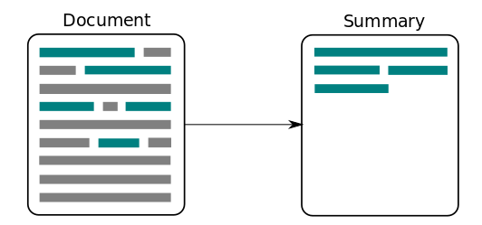

NLP Summarization Techniques
Abstract Text Summarization: Let Transformers Summarize for You!
DATA606: Capstone in Data Science
Final Project, Fall 2022
Lee Whieldon

Slide 2
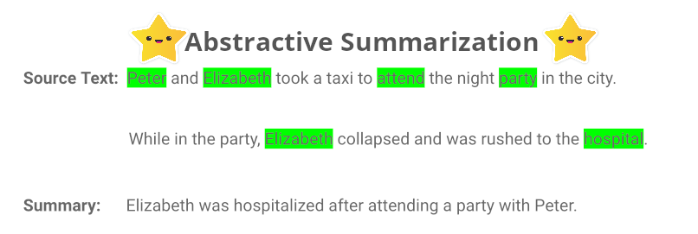
What is the value of abstract text summarization?
Time Saving – Summarization of Long Meeting Transcripts
Consistency – Summarize complex corpus of text like contracts
Customer Satisfaction – Distilling collection of dialogue into an actionable summary

Slide 3
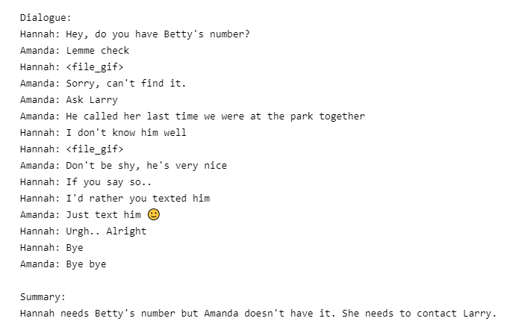
Data - SAMsum Corpus
Features:
Dialogues
Summaries
Ids – unique identifier
Data Splits:
Train: 14,732 records
Validation: 818 records
Test: 819 records
16,369 dialogues in total

Slide 4
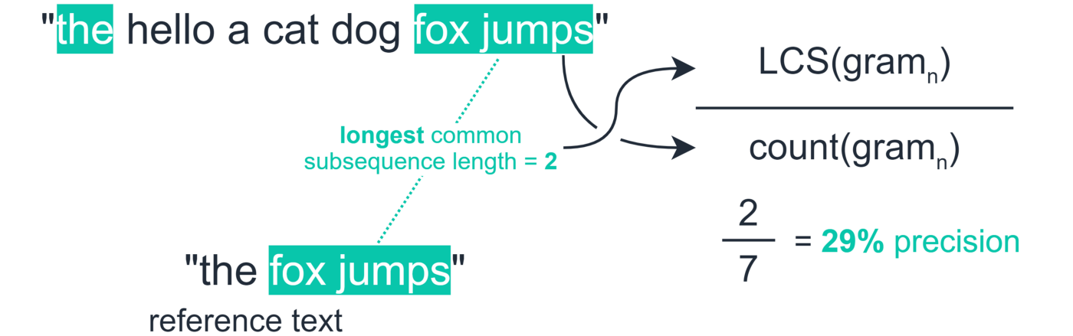
Scoring Metrics
Recall-Oriented Understudy for Gisting Evaluation – ROUGE!
Developed for automatic summarization and machine translation software
High recall is more important than precision scoring alone
Longest common subsequence (LCS): Help calculate the score per sentence and averages it for the summaries
We also calculate the score over the whole summary (ROUGE L-Sum)

Slide 5
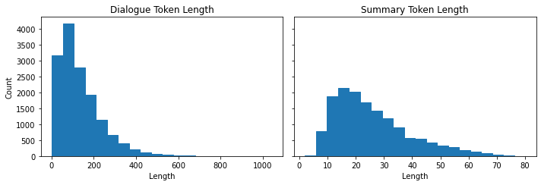
Pretraining Analysis
Length of distribution:
Each Dialogue records contain 100-200 tokens (a.k.a. words)
Summaries are shorter, with around 20-40 tokens

Slide 6
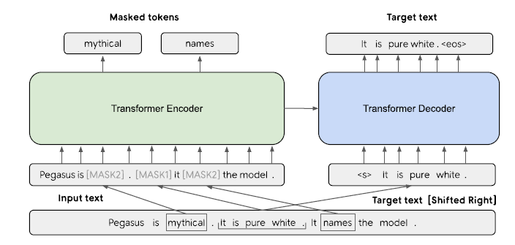
Model - PEGASUS
Encoder-decoder transformer
Pretraining objective is to predict masked sentences in multisentence texts
Applying Gap Sentence Generation (GSG)
Applying Masked Language Modelling (MLM)

Slide 7
Training & Evaluation
Google’s Pegasus-CNN_DailyMail
Transfer learning from google/pegasus-cnn_dailymail .
Training hyperparameters
Learning rate: 5e-05
Training results
Train batch size: 1
Eval batch size: 1
seed: 42
Gradient accumulation steps: 16
Total train batch size: 16
optimizer: Adam with betas=(0.9,0.999) and epsilon=1e-08
Lr scheduler type: linear
Lr scheduler warmup steps: 500
Number of epochs: 1
Training Loss: 1.6776
Epoch: 0.54
Step: 500
Validation Loss: 1.4919

Slide 8
Conclusions & Limitations
Not applicable for long corpus
Most models today can handle up to 1,000 characters
Research is actively being done today to account for this limitation
Expedited processing with greater GPU clusters

Slide 9

Demo!

Slide 10
Thank you!
Looking forward to seeing everyone’s projects!

